Slide 1
Chapter 1: Business and
Its Legal Environment

Slide 2
Business Activities
Knowledge of ‘black-letter’ not enough - business now assumes an ethical dimension.
Many Different Laws May Affect a Single Business Transaction.
Ethics and Business Decision Making. →

Slide 3
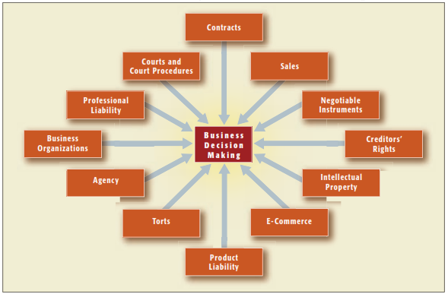
Ex. 1-1 Areas of the Law That May Affect
Business Decision Making

Slide 4
What are the Sources of American Law?
Constitutional Law.
  Federal
  State
Statutory Law.
  Federal
  State
  Ordinances
  Uniform Commercial Code
Administrative Law.
  Federal Agencies
  State and Local Agencies→

Slide 5
Sources of American Law
Case Law and Common Law Doctrines.
  Case law governs all areas of law not covered by statutory or administrative law.

Slide 6
The Common Law Tradition
Early English Courts.
  American law is based largely on English Common Law which was based largely on traditions, social customs, rules, and cases dating back to 1066 A.D.
  Precedent.

Slide 7
The Common Law Tradition
Stare Decisis (“to stand on decided cases”) is judge-made law.
  Departures from Precedent. In cases of “first impression” a court may refer to positive law, public policy, or widely held social values to craft the decision.

Slide 8
The Common Law Tradition
Equitable Remedies and Courts of Equity.
  Remedy: means given to a party to enforce a right or compensate for the violation of the right.
    Remedies in Equity. Equity is “beyond law” and looks at notions of fairness and justice. →

Slide 9
The Common Law Tradition
Equitable Remedies and Courts of Equity.
  Equitable remedies include: specific performance, injunctions, rescissions.

Slide 10
Schools of Legal Thought
Natural Law School. →
Positivist School. →
Legal Realism. →

Slide 11
Schools of Legal Thought
Natural Law School.
  Adherents believe a higher or universal law exists that applies to all humanity, and all written laws should imitate these principles.
  Laws contrary to natural law are “unjust” and need not be obeyed. →

Slide 12

Natural Law In History
“[T]here are two types of laws: just and unjust laws. . . . A just law is a man-made code that squares with the moral law . . . . An unjust law is a code that is out of harmony with the moral law. . . . An unjust law is a human law that is not rooted in eternal and natural law.” Martin Luther King, Jr., Letter from the Birmingham Jail, April 16, 1963.

Slide 13
Schools of Legal Thought
Legal Positivism.
  Law is the supreme will of the State and must be abided.
  Law, and therefore rights and ethics, are not universal. Whether a law is “good” or “bad” is irrelevant.

Slide 14
Schools of Legal Thought
Legal Realism.
  Law is not simply the written law, but a product of the views of judicial decision makers, as well as social, economic, and contextual influences.

Slide 15
Classifications of Law
Law will be either:
  Substantive or Procedural.
  Civil or Criminal. →
  Public or Private.

Slide 16
Classifications of Law
Civil Law vs. Criminal Law.
  Civil Law: defines the rights between individuals or individuals and governments.
  Criminal Law: defines an individual’s obligations to society as a whole.
  Burden of proof

Slide 17
Appendix to Chapter 1: Finding and Analyzing the Law
Finding Statutory Law and Administrative Law.
  United States Code (USC).
  State Codes.
  Administrative Rules.

Slide 18
Appendix to Chapter 1: Finding
and Analyzing the Law
Finding Case Law.
  State Court Decisions.
    Regional Reporters.
    Case Citations.
  Federal Court Decisions.
    U.S. Supreme Court decisions are published by the federal government in United States Reports (U.S.).

Slide 19
Appendix to Chapter 1: Finding
and Analyzing the Law
Reading and Understanding Case Law.
  Case Titles and Terminology.
    Parties to Lawsuits.
    Judges and Justices.
    Decisions and Opinions.

Slide 20
Appendix to Chapter 1: Finding
and Analyzing the Law
Legal cases are identified by a “legal citation” (or a “cite”) as the sample below:
  Fehr v. Algard, ___ N.J. Super ___, A.3d (2011).
Title: First Party is Plaintiff, second party is Defendant. The parties are either italicized or underlined.

Slide 21
Appendix to Chapter 1: Finding
and Analyzing the Law
Legal cases are identified by a “legal citation” (or a “cite”) as the sample below:
  Fehr v. Algard, ___ N.J. Super ___, A.3d (2011).
The case is from the Superior Court of New Jersey and is not numbered as of the date of this printing.

Slide 22
Appendix to Chapter 1: Finding
and Analyzing the Law
Legal cases are identified by a “legal citation” (or a “cite”) as the sample below:
  Fehr v. Algard, ___ N.J. Super ___, A.3d (2011).
The case was decided in 2011.

